Slide 1
Enzymes of The Digestive System
WALT:
Understand that enzymes are specific to particular types of food

Slide 2
Enzymes
Enzymes are substances that increase the rate of a chemical reaction.
Without enzymes in the digestive system we would not be able to digest our food fast enough for our needs.

Slide 3
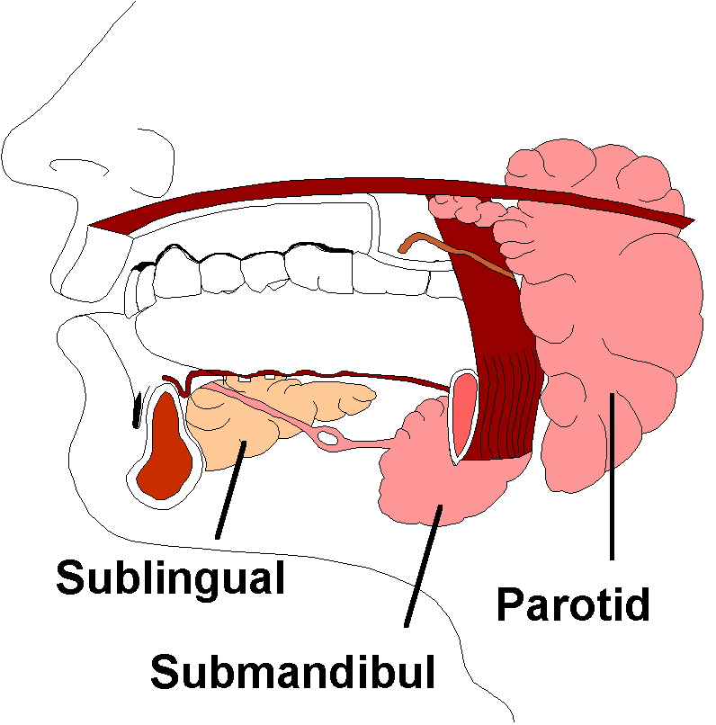
Chemical digestion in the mouth
Enzyme | Acts on | Product
Amylase (in saliva) | Starch → | Sugars

Slide 4
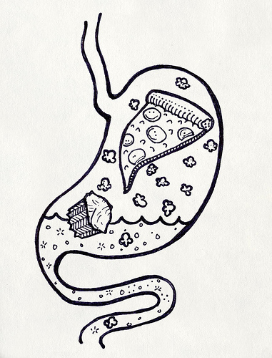
Chemical digestion - Stomach
Enzyme | Acts on | Product
Hydrochloric acid | Activates pepsinogen → | pepsin
Pepsin | Proteins → | polypeptides

Slide 5
Bile
Bile is produced by the liver and stored in the Gall Bladder.
It is released from the Gall Bladder into the duodenum.
It is NOT an enzyme but is often mentioned with enzyme action.
Bile (Bile salts) act like detergents and emulsify fats, breaking them into smaller droplets.
This is mechanical digestion to increase surface area to aid lipase action.

Slide 6
Chemical digestion in the duodenum
(these enzymes are produced in the pancreas)
Enzyme | Acts on | Product
Amylase | Starch → | disaccharides
Protease | Proteins → | polypeptides
Lipase | Lipids → | fatty acids + glycerol

Slide 7
